Slide 1

Introduction to Container
Chapter One

Slide 2
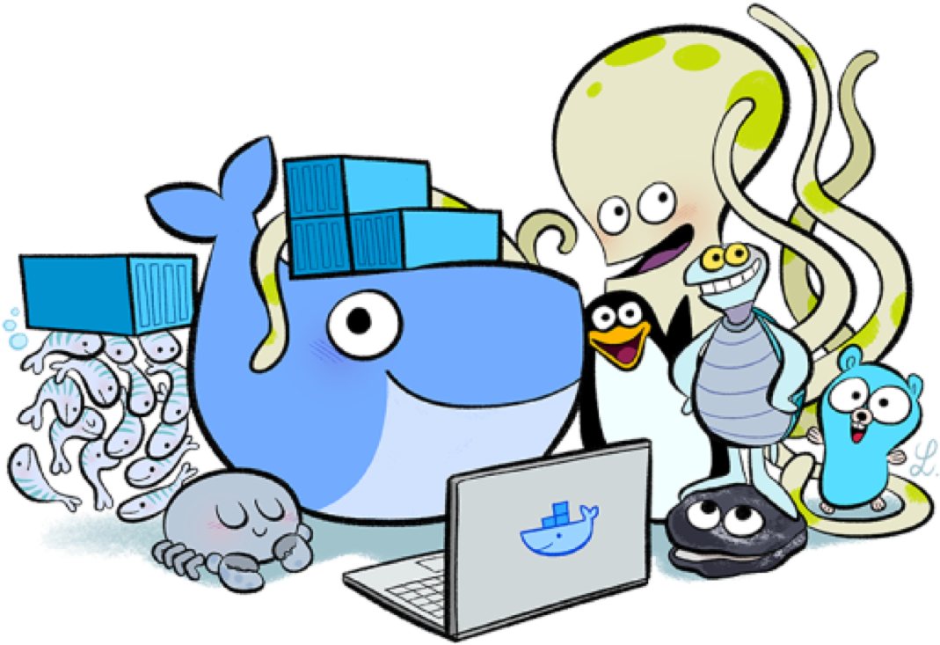
Objective
What are containers?
Why do we need containerization?
How do containers work?
Security
Container Runtime/Engine

Slide 3
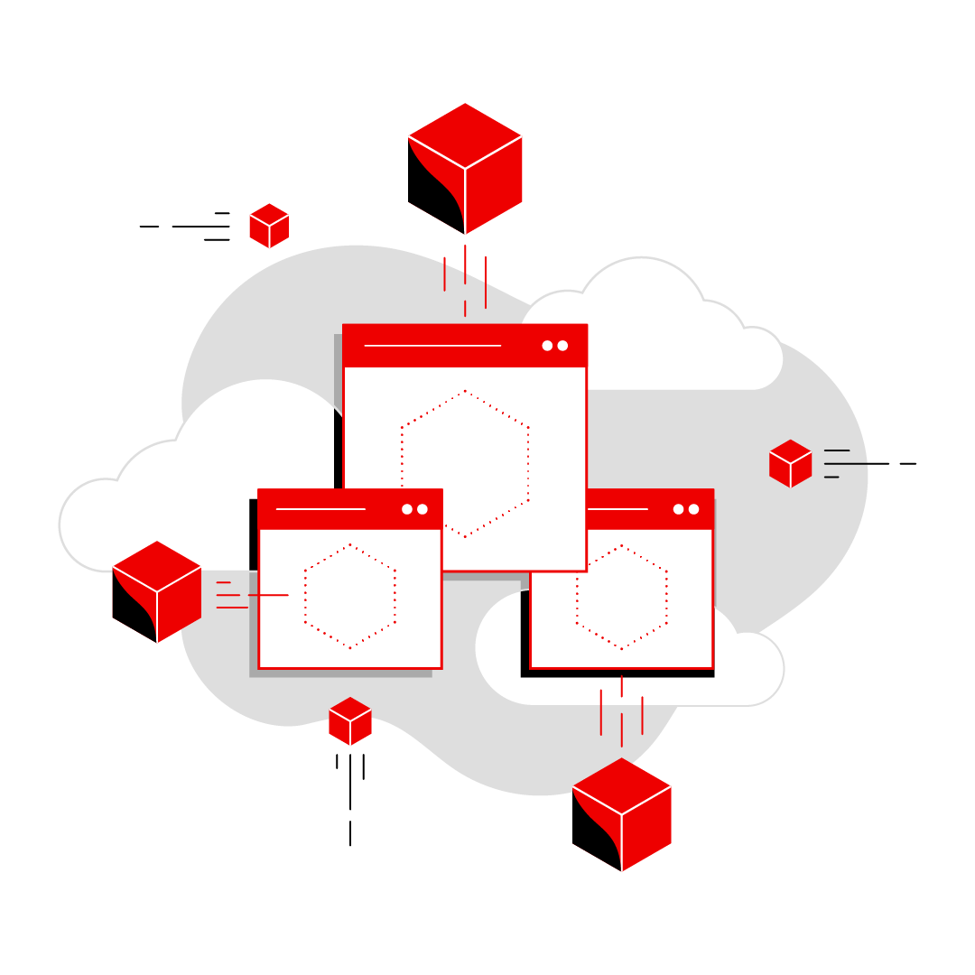
What are containers?
Explain
Technologies that allow you to package and isolate applications with their runtime environment
Lightweight packages of your application code together with dependencies such as specific version, programing language runtimes and libraries to run your software services
This makes it easy to move the contained application between environments (dev, test, production, etc.) while retaining full functionality.

Slide 4
What are containers?
Explain
Standardization, Facilitates, Mass scale

Slide 5
Why do we need containerization?
Portability
Easy to share source code
Independent
Scalability
Easy to scale up/down
Ability to increasing workloads
Faster Deployment
Lightweight and easy to configure
Create multiple containerized instance on-demand
High Productivity
Enhanced Security
Continuity
Easy Management
Complete sets
Reconfiguring existing architecture
Official application images in-place
Multiple environment
Using platform’s source code to run
Save time while installing on different platform
App isolation
Expose only required services/ports
Separate containers have their level of security
Easy to roll back and deploy
Failure of one will not have impact of others
Many container orchestration tools like Docker Swarm, Kubernetes, etc...
Docker Compose
Notes:
1) Portability
By abstracting applications away from the host Operating System, a container environment makes applications run smoothly on any platform or cloud. The OS consolidation method also avoids the occurrence of integration and other inconsistencies that might obstruct the app functionality. Thus, applications are highly portable and effective when run across different servers.
2) Scalability
Containers technology offers higher application scalability. With a service-oriented application design, a container application holds the ability to handle increasing workloads. This can be achieved by reconfiguring the existing architecture to allow additional resources or by adding more containers within the cluster of distributed machines.
A container environment allows you to add new functions, features and updates instantly without affecting the original application. This way, containers allow application scalability with minimum resource usage.
3) Faster Deployment
Containers are termed ‘lightweight’ because of their ability to speed up the application configuration and deployment processes. A Docker container can create a master version of an image (main application) that can be deployed quickly on demand.
A container environment ensures higher flexibility in creating multiple new containerized instances of an application as and when needed on-demand.
4) High Productivity
Containers are known for their abilities to facilitate a rapid development environment to generate more applications. Since portable applications use the platform’s source code to run, containers allow developers to change and track the changes in the platform’s source code, thus enhancing productivity.
By reducing the dependency on the main server or OS resources, they simplify and save time while installing applications on different platforms.
5) Enhanced Security
Since applications run independently in separate containers, each of them will have their level of security. This feature of app isolation helps share additional features without any risk factor. If you are working with the development team outside your network, all you need to do is just share the required resources without any critical information within your network.
6) Continuity
Since different containers run independently, failure of one will not have an impact on the continuity of others. Developers will have the flexibility to rectify errors in the identified container, without causing downtime of other containers. Thus, containers ensure continuity in operations.
7) Easy Management
Container orchestration tools take care of application management, automating installation, scaling and management of containerization workloads. They perform logging, debugging, version updates and more related to containerized apps. Kubernetes is one most popular container orchestration tool.
By now, you must have realized the benefits of container technology. There are many such that container technology services can offer to your business to give you a competitive edge.

Slide 6
Why do we need containerization?
Explain
Deployment Nightmare
Tier | Development | QA | Staging | Prod
Frontend | ? | ? | ? | ?
Backend | ? | ? | ? | ?
Cache | ? | ? | ? | ?
DB | ? | ? | ? | ?

Slide 7
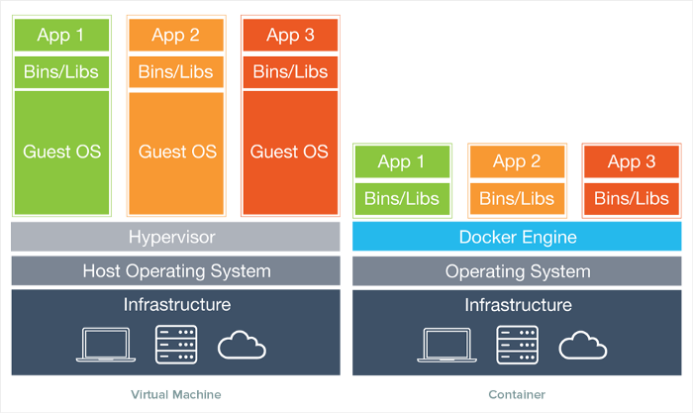
How do containers work?
Infrastructure
Containers leverage kernel features to create extremely lightweight encapsulation:
Kernel namespaces
Network namespaces
Linux containers
Cgroups
Speed and resource utilization
Notes:
Docker runs under the host system kernel, the containers contains only user space files and all resources, configuration needed, libs, dependencies and executable commands are defined through images which are light and easily adaptable for different purposes.

Slide 8
How do containers work?
Infrastructure
Encapsulation Virtual Machine
Virtual machines require allocated CPU and memory
Significant overhead from OS
Notes:
Differently from VM's, Docker does not emulate the entire OS on the host machine and that is why is so light compared to VM. The Docker Engine works like a middleware managing the containers process along the host OS. The containers with Docker only loads the necessary bins/libs (and the app obviously :P ) for your App to run.
Credit: https://peaonunes.medium.com/an-introduction-to-the-container-world-with-docker-6fd613f6b9c2

Slide 9

Security
“Gartner asserts that applications
deployed in containers are more secure
than applications deployed directly to the OS”
https://blogs.gartner.com/joerg-fritsch/can-you-operationalize-docker-containers/

Slide 10

Security by default
Automatic:
Kernel namespacing
Root capability restrictions
Linux security modules
Management plane TLS encryption
Optional:
Cgroup limits
User namespace remapping
Data / Control plane encryption
Customization of all defaults

Slide 11

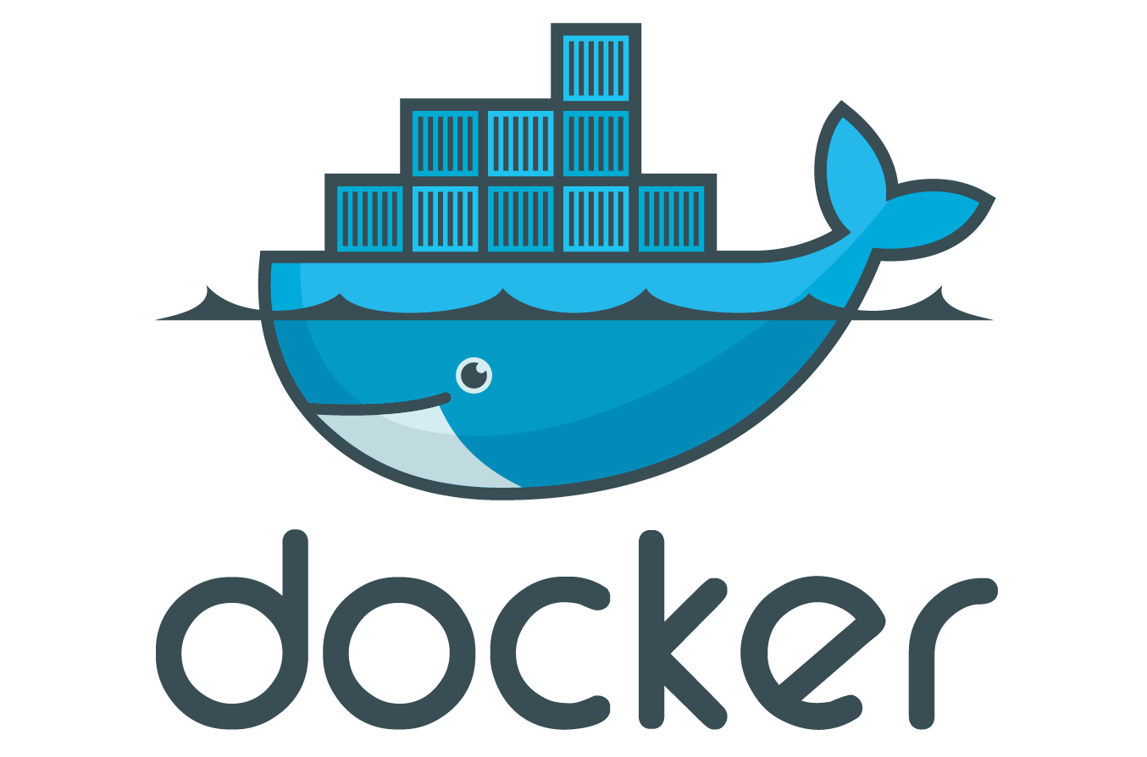
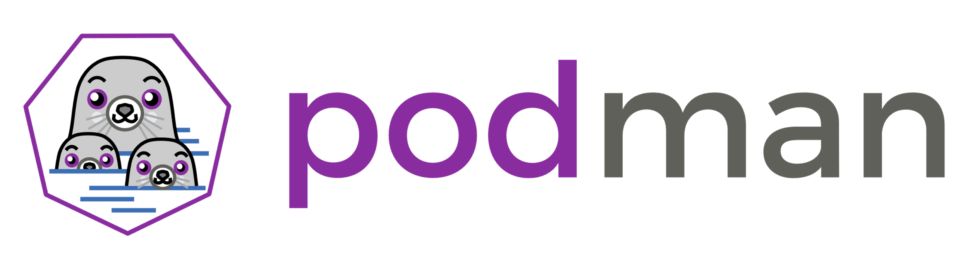

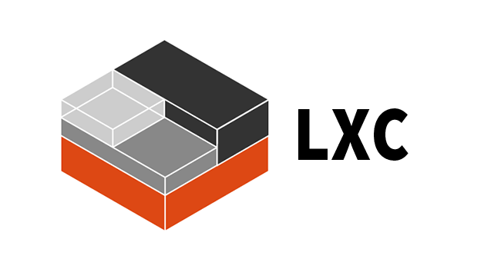
Container Runtime/Engine
Docker
CRI-O
RKT
Railcar
LXC
podman
Notes:
https://kubernetes.io/blog/2017/11/containerd-container-runtime-options-kubernetes/

Slide 12





Questioins
www.passerellesnumeriques.org

